Slide 1
The assets of SSAH for the future in evidence-informed policymaking
Lidia Borrell-Damian, Secretary general
session on Innovation in Evidence-informed policy making (EIPM) ecosystems: the added value of SSAH
Part of the 2024 Belgian presidency conference on
#StrongerTogether: SSAH and the future of evidence-informed policymaking
Tervueren, Belgium
07 may 2024

Slide 2
About science europe

Slide 3
What is Science Europe?
Our mission is to define and advocate long-term perspectives for European research and champion best-practice approaches, promoting high quality science for the benefit of humanity and the planet.
Science Europe is the European association representing the interests of major
public research performing (RPOs) and
research funding organisations (RFOs)
that foster excellent, ground-breaking research in Europe.
Science Europe is a research policy organisation; it has no research funding or performing role.

Slide 4
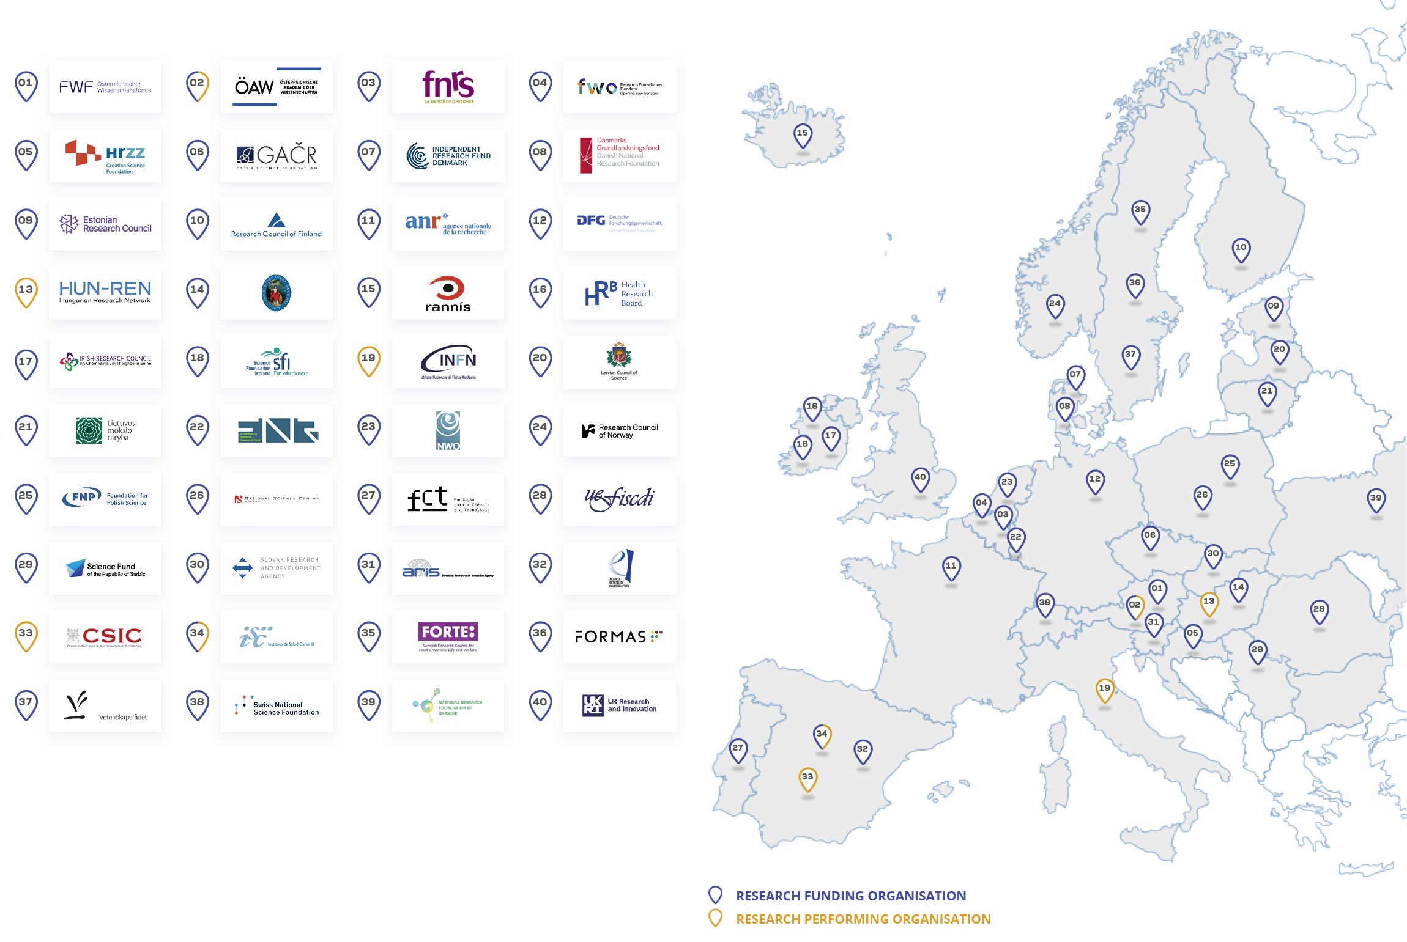
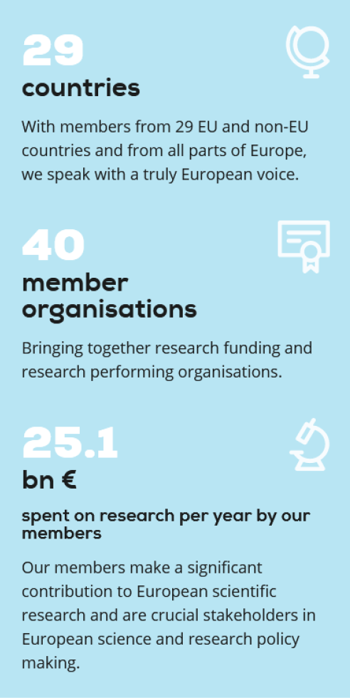
Science Europe Member organisations
Science Europe is the association representing national public organisations that fund and perform research in Europe.

Slide 5
We consider scientific knowledge to be for the common good and that research is a public service.
We value and protect the freedom of scientific inquiry and the self-organising nature of the scientific research system.
We acknowledge the responsibility of all actors in ensuring the highest possible standards of quality, ethics, integrity, inclusivity, and openness in the conduct and management of research.
We recognise the strong links between research, education, and innovation.
We believe that collaboration within the R&I system and engagement with and for society are constitutive elements of science.
The members of Science Europe defined these values believe in the sharing of good practices as a way to advance research policy and advocacy.

Slide 6
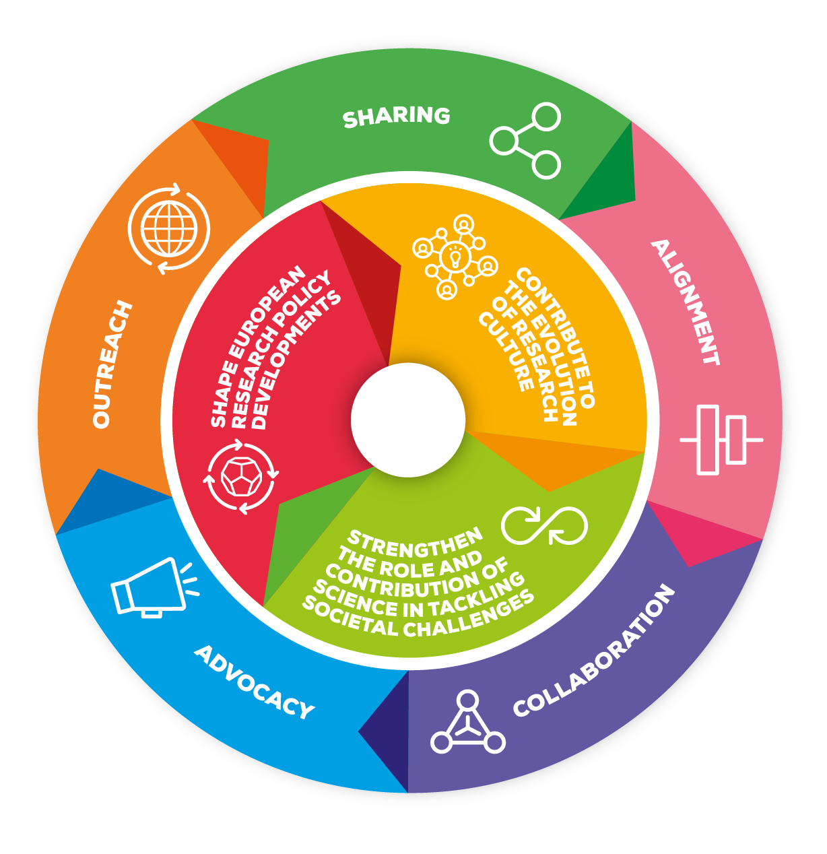
Three Strategic priorities and five purposes Strategy and multiannual action plan 2021–2026
Shape European research policy development
Contribute to the evolution of research culture
Strengthen the role and contribution of science in tackling societal challenges
https://scieur.org/strategy
https://scieur.org/maap

Slide 7
Key factors on science for policy activities

Slide 8
Recent knowledge provided by science Europe members
A 2023 SURVEY-BASED REPORT IDENTIFIES SCIENCE EUROPE’S MEMBERS ACTIVITIES FOR SCIENCE-INFORMED POLICYMAKING
KEY MESSAGES
Recognise, assess, and support ‘Science For Policy’ (S4P) activities
Develop strategies with long-term vision, resources, expertise, data and methods.
S4P activities are relevant in all fields and for all types of policymaking and scientific disciplines.
Trust and mutual respect between researchers and policymakers are crucial

Slide 9
Context conditions for evidence-informed policy making (EIPM)
Geopolitical, environmental, human rights challenges need solutions stemming from an interdisciplinary agenda, as they encompasses a wide variety of factors which cannot be analysed separately.
Science-informed and evidence-based policy making requires interdisciplinary and systemic approaches to assess different options, overcome personal biases and, ultimately, improve the way societal challenges are addressed. For these reasons, Science for Policy activities should always be seen as a collective process aiming to mobilise knowledge to tackle societal challenges.
Research funders and performers can play an important for in supporting evidence-based policy making, by acting as intermediaries in both directions: identifying policy demands and relevant research findings, and then enabling the interplay between science and decision making.
Creating and reinforcing interdisciplinary Science for Policy networks can be an important channel for science communication, and these networks can support, promote and disseminate complex science findings on various topics such as energy, climate, economics etc, and act as crucial knowledge for transformative change.

Slide 10
Context conditions for evidence-informed policy making (EIPM)
SCIENTIFIC RESEARCH CAN AND SHOULD SUPPORT POLICYMAKERS IN NAVIGATING COMPLEX, KNOWLEDGE-DEMANDING CHALLENGES
Bi-directional exchanges
A longstanding, complex relationship
Science is back crucial for decision-makers in turbulent times of fake news and misinformation
Several initiatives to improve science-policy ecosystems, in Europe and globally. E.G. EU Council Conclusions 8 December 2023
Emergence of Artificial Intelligence

Slide 11
The importance of the arts, social sciences and humanities disciplines
Outcomes of Arts, Social Sciences and Humanities (ASSH) research are natural assets for science-informed policy making, on an equal basis as those from Science, Technology, Engineering and Mathematics (STEM) disciplines.
Outcomes of multi-, inter- and trans-disciplinary ASSH-STEM research foster better informed policy decision-making through a thorough understanding of the interactions between facts, values, identities, collective and individual experiences, and beliefs.
Including ASSH and STEM disciplines from the outset of R&I projects can help to develop a new perspective on impact, less focused on economic, short-term results, but more on transformative changes and shift in values, which can be beneficial when assessing impact of public policies for the common good.
An example of evidence-based policy making on European level are the revisions of the SET plan, which have been concretely involving SSH in defining needs and challenges for EU energy policy.

Slide 12
Principles and Values for science for policy activities
INSTITUTIONAL MANDATE
QUALITY, INTEGRITY, TRANSPARENCY
RESOURCES
OPTIONS, MORE THAN ADVICE

Slide 13
Principles and Values
INSTITUTIONAL MANDATE
Need an explicit institutional mandate given by policy makers to a dedicated body, properly recognised by the scientific and policy community.
QUALITY, INTEGRITY, TRANSPARENCY
Research activities need to explain their process of gathering scientific contributions transparently. The official mandate must ensure the highest quality and scientific integrity, while relying on the clear commitment and engagement of both researchers and policy makers.
RESOURCES
The mandate for Science for Policy activities needs to be associated with dedicated resources, including qualified personnel, sufficient funding, and adequate organisational settings.
OPTIONS, MORE THAN ADVICE
Science for Policy activities should aim to contribute to policy making as ‘one of the sources’ for decision makers. These activities should present scientific and evidence-based options, rather than prescriptive recommendations.

Slide 14
EXAMPLES from science Europe member organisations

Slide 15
Health Research Board, Ireland
A long-term and well-advanced strategy for S4P activities, promoting engagement on policy and research sides
Building in-house capacity, investing in long-term research support and working with policymakers to identify key questions
See the HRB Evidence Centre conducting annual evidence reviews, focusing on policy questions from the Irish ministry for health
Encouraging researcher engagement
Compiling impactful insights
Spotlighting emerging trends
Facilitating knowledge translation
Enabling research-policy exchanges
Navigating complexity with evidence
Investing in evidence synthesis capacity
Empowering trials and multicentre studies
Monitoring long-term trends
Strengthening data infrastructure

Slide 16
Foundation for Science and Technology, Portugal
SELECTED ACTIONS
Thematic R&I Agendas co-designed with experts and companies to identify national challenges, aligning research & policy priorities in selected areas
Multi-actor protocols to facilitate the regular exchange of information, knowledge and priorities in the areas of social sciences, with a specific call for public policy studies, a call for PhD fellowships directed to, among others, public administrations.
Prizes to reward researchers engaged in science for policy activities (E.g., the prize “Impact of Science on Economy and Society in Portugal”).

Slide 17
Spanish National Research Council
A statutory mandate for S4P activities in Spain in the broad areas of science & technology
An evolving role from pure ‘knowledge generator’ to integrate the role of ‘knowledge synthetiser’.
An articulated set of instruments
The ‘Science for Public Policy’ collection: 8 reports contributing to defining evidence-informed policies (since June 2023).
The Cicero Itineraries: events where politicians, entrepreneurs and journalists can visit csic labs and learn about specific topics
Support to the Spanish government on emergency action protocol.
Interdisciplinary thematic platforms (PTIs) & the CSIC Hubs gathering different research groups & stakeholders (incl. Public Adm.) addressing societal challenges.

Slide 18
Swedish research council for sustainable development
The Swedish research council for sustainable development (FORMAS) has the institutional mandate to foster collaborations between researchers and stakeholders.
The Council for Evidence-based Environmental Analysis ensures the alignment between national priorities and research evidence synthesis, offering valuable insights on research evidence and recommendations to the Swedish government, following the guidelines for environmental evidence, detailing the steps to ensure integrity and transparency. The Council also provides socio-economic and cost-effectiveness / cost-benefit analyses. The analysis focuses on pointing out possible alternatives and their implications.
For this mandate, FORMAS has specific financial and staff resources. The syntheses are published and openly available, and are disseminated through seminars, roundtable discussions and other relevant fora.

Slide 19
UK Research and Innovation
SELECTED ACTIONS
The “Centre for the Evaluation of Complexity Across the Nexus” (CECAN), funded by UKRI at the Surrey Univ. A pioneer centre testing and promoting innovative policy evaluation approaches and methods through a series of 'real-life' case study projects.
The UKRI-supported RIDE Forum unites 24 public sector bodies to enhance environmental research and innovation by facilitating collaboration, reducing duplication, and informing policymaking effectively.
The UKRI internal systems to scan in-house policy-oriented expertise, including a system of incentives to engage researchers in policymaking.

Slide 20
Bibliographic sources

Slide 21
Bibliographic Sources:
Sources from Science Europe :
Building a scientific narrative on impact and societal value of science, November 2016
Call to action to research organisations for the Net-Zero Transition, SE, CESAER, ISCN, University of Glasgow, November 2021
Response to the Public Consultation on Horizon 2020 and Horizon Europe, Science Europe, February 2023
Science–Policy in Action: Insights for the Green and Digital Transition, Science Europe, March 2023
Interdisciplinarity for the Net-Zero Transition : the perspectives of universities and research organisations, April 2023
Guidance on science policy activities, Science Europe, April 2024

Slide 22
Any questions? Lidia.Borrell-Damian@scienceeurope.org
https://www.scienceeurope.org/

